Slide 1


NIE INSTITUTE OF TECHNOLOGY
(Approved by AICTE, New Delhi and affliated to VTU Belagavi) No. 50(part) Hootagalli Industrial Area, Koorgalli Village,Mysuru-570018
Department of Information Science Engineering
Title :-
Areca Nut Climbing and Spraying machine using Android
Team :
Guided by :
G Prasanna Kumar
Dept of ISE
NIEIT
Harsha K G (4NN19IS011)
Ateeq ur Rahman (4NN19IS004)
Manvanth B C (4NN19IS018)
Inchara A D (4NN19IS012)

Slide 2
INTRODUCTION
The objective of this project is to design and develop a robot which can climb the Areca-nut tree and spray pesticide, thereby reducing time and labour required for the same job
The design and fabrication of arecanut tree climbing and spraying machine consists of a Hexagonal base aluminium frame which supports all the components to be built upon.
It incubates with DC motors and container to carry the pesticides that has to be sprayed. DC geared motors having reduction gears which ensures self-locking of the tyres and thus maintains the stability at heights.
The device is controlled through mobile app via bluetooth connectivity. This gives effective control over the machine.
Will install camera module which could be helpful for user to determine any major defect on nuts.
sprayers used in this machine are more efficient and effective such that it could target one with trees around simultaneously.

Slide 3
Existing System
The robot consists of an ‘X’ frame. At the bottom of the robot two rollers are placed which are conical in shape and are connected to two DC motors.
These motors are operated by a wired remote control to move up and down the tree. The model is placed around the tree and springs are used to attach it firmly to the tree. Two nozzles are placed on either side at the top of the machine with motor arrangement so that it can rotate at a 360-degree angle.
Electric pumps are used to lift the pesticide towards the nozzle and spray it to the Arecanut.
Arduino Uno is used for programming the motors to rotate in clockwise and anticlockwise direction.
Controlling is done through remote access (i.e wired connection).
single sprayer
The future improvements of the existing project are as follows: -
I. Adding a nut cutter.
II. Lowering the weight.
III. To utilize better Frame for load distribution
IV. The process of spraying pesticide can also be made fully automatic and sprayed simultaneously to trees around
V. Wheels with better frictional co-efficient can be designed

Slide 4
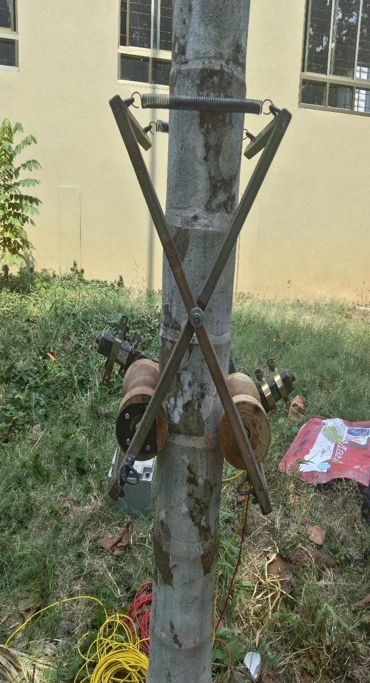
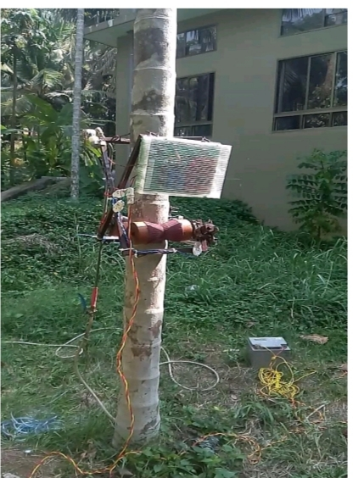

Slide 5
Proposed System
The design and fabrication of arecanut tree climbing and spraying machine consists of a a Hexagonal base Aluminium frame which supports all the components to be built upon.
It incubates with DC motors and container to carry the pesticides that has to be sprayed. DC geared motors having reduction gears which ensures self-locking of the tyres and thus maintains the stability at heights.
The device is controlled through mobile app via bluetooth connectivity. This gives effective control over the machine.
Will install camera module which could be helpful for user to determine any major defect on areca nuts.
sprayers used in this machine are more efficient and effective such that it could target one with trees around simultaneously.
A 3+3 wheels are attached to the machine to climb on.

Slide 6
LITERATURE SURVEY

Slide 7
PAPER-1: Tree Climbing Device PUBLISHED: Volume 5, Issue 12, December 2018 AUTHOR : Mr. Vineet Awasthi
Introduction
Farmers used to manually climb the trees to the top in olden days and spray pesticide into the areca nut bush.
They would jump to the neighboring tree after spraying pesticides into the Areca nut.
The aim of this project is to design and develop a robot capable of climbing the Arecanut tree and spraying pesticide, reducing the time and work required for the same job.
Methodology
After the robot has been attached, springs are used to fix the robot firmly to the tree.
The robot operates on 12V 42 Ah battery and climbs the required height very quickly.
Once the robot reaches the required height it stays there without slipping.
The sprayer covers a wide angle and sprays pesticide to the arecanut bunch on the nearby tree up to a radius of 15 to 20 metres.
After spraying is done it smoothly descends the tree. A solenoid valve is used to stop or resume the flow of pesticide.
All the above functions of the robot are controlled by remote.

Slide 8
Advantages
it reduces time and dependence on labour
powerful sprayer - use of solenoid valve
operated from a safe distance without exposing the farmer to the harmful effects of pesticide
person with little technical knowledge can assemble it in an ordinary workshop.
robot is attached and removed easily to the tree.
Drawbacks
Robot weight is high ( 8kgs) due to use of Iron body
Wheels with less frictional coefficient
Use of lengthy wire and pipes
Battery is not installed within the robot

Slide 9
PAPER-2: REMOTE CONTROLLED ARECANUT PLUCKING MACHINE PUBLISHED:Volume: 05 Issue: 04 | Apr-2018 AUTHORS: Fasil TK, Jishnu K Das, Shabeeh AP, Xavier Saji, Prof. Jacob Kuriakose
METHODOLOGY & ADVANTAGES
The experimental setup consists of a main frame on which the main components of the machine are mounted.
The cutting operation is carried out by the cutting tool during the unwinding operation carried out by the motor. This operation gives enough power for the cutting tool to produce a cutting action.
The collector present along with the cutting tool collects the areca nut and prevent it from falling to the ground and thus helps in reducing the overall
time by eliminating the time required to collect the areca nut from ground.
Climbing up approach is carried out by the blue tooth.
Lowering of the machine should be done through manually by the iuse of rope attached to the rubber tyres helps in proper step down approach.
The motor shaft is welded to the drum which winds the steel rope. Thus, when the motor rotates, the drum rotates and the string is wound over the drum.
During the drum winding, the spring gets contracted and spring force acts along the direction opposite to the applied force.

Slide 10
Drawbacks:
Descending of the machine should be done manually.
The entire operation is controlled from the ground via Bluetooth but bluetooth range should be increased.
Compact and simple in geometry which is not gripper to the tree.
Used only to cut the areca branch.
Bulk in weight and length is taller and not in a proper geometry.

Slide 11
PAPER-3: MOTORIZED ARECANUT CLIMBER AND PESTICIDE SPRAYER PUBLISHED: JIDPS Volume-2,Issue-7 (July-2019) AUTHORS:Mohammed Said U Y, Shillin K S, Anil D Koola, Dr.Ragesh Sathiyan M, Dr.S.Senthil Kumar.
METHODOLOGY & ADVANTAGES
It use simple method to climb the Arecanut Tree and cut the Arecanut and spray the Pesticide.
It should perform on the tree by the control of a man in ground itself.
It contains 2 rollers. It mounted on the slot of supporting beam.
It is made up of steel it will hold the motor, battery, spraying system, wheel and whole system also the cutter is fixed on it.
The roller assembly consists of two rubber wheels mounted on the shaft wheels of 100mm outer diameter is used. These roller assembly is mounted on the slots provided in the supporting beam.
The motor we are using is a low speed DC motor .it is a 12 VOLT, 4AMP motor having a speed of 40RPM.
The motor is connected to mobile app and it connected to battery, here we use wifi for wireless connection.

Slide 12
DRAWBACKS:
It is not affordable.
It is not in light weight, beam weight is more.
It can't be easily detachable from the tree.
Motor power is much required than the existing as it is more in weight.
Frictional co-efficient is less.

Slide 13
PAPER-4: Design and fabrication of areca nut climber and harvestor PUBLISHED: IJRESM – March 2021 AUTHORS: R. Thirupathi , N. K. Adarsh , R. Akash , N. Lakshmana Prabhu, T. Karthikeyan
METHODOLOGY & ADVANTAGE:
It consists of two pulleys, springs, rollers, knife, rope and clamps with rubber padding for operations.
It uses a rope, pulley and spring mechanism to climb the tree.
Initially the device is fitted on the lower stem of the tree using clamps and bolts.
When the rope is pulled through the pulleys the spring is compressed and the lower part of the device is pulled up that is the lower clamp moves up this is done by the pulleys fitted on the back side.
When the rope is released the spring expands as a result the upper part of the device moves upwards. This is continued till the device reaches the top.
Then the separate rope used for the cutting operation. Then pull the other rope to bring back the machine down.

Slide 14
DRAWBACKS:
needs man involvement in more amount
This may harm the tree while climbing, due to compression of springs
no proper data regarding the machine operation
no long life of the machine for working environment and proper usage

Slide 15
PAPER-5: AUTONOMOUS TREE CLIMBER: ROBOT FOR ARECA NUT PLUCKING PUBLISHED: Vol. 3, No. 2, June – August 2018 AUTHORS: Rakesh B Shettar, Suganda Pendem
METHODOLOGY & ADVANTAGES
This robot will work by using power source as external dc source or by using solar panel dc current. This current is supplied in remote control, which controls the motion of motors.
To design the robot specification of arecanut plant are taken into consideration and also the effect of monsoon and summer on arecanut plant. Design robot body, climbing mechanism, cutting mechanism and programs related to motion are to be done.
Final design of robot machine is analysed with the help of software for load, power, material and its working to check the required results.
Then the cutting mechanism is made by using DC motor. As a finel step, fabrication of robot arm and assembling the integrated unit
Working: Attach the device to the tree, Send climb up signal,Upward movement of the device,Send stop signal Adjust the arm to the position of the arecanut bunch,Cut the arecanut bunch,Send down signal Downward movement of the device, Detach the device from the tree.

Slide 16
DRAWBACKS:
Weight was overloaded.
Grip was not sufficient and started slipping at some point due to bad design
Unskilled labour cannot able to monitor the device
Wired control ,the wires may lag up at some instant when lifting up the tree.

Slide 17
PAPER-6: Design and Fabrication of Arecanut Tree Climbing Machine PUBLISHED:Volume: 06 Issue: 03 | Mar 2019 AUTHORS: Uvaraja V C, Manohar N, Murali prasath S, Mohana Krishnan S, Vishnu Sankar S S
METHODOLOGY & ADVANTAGES:
This project comprises of a triangular base edge which underpins every one of the parts to be based upon.
It is fitted with three DC motors - nylon tires with elastic grippers at 120 degrees each other for simplicity of the tasks. An exceptionally structured remote controlled machine.
Power from the battery is provided to the motors utilizing adaptable wires and DPDT (Double Pole Double Throw) change is utilized to control the development of climbing machine.
DC adapted motors having decrease gears which guarantees self-locking of the tires and along these lines keeps up the stature.
To oblige for change in the breadth of arecanut tree as the machine climbs up and down, a spring stacked system is utilized for applying adequate strain required for grasping the tree.

Slide 18
DRAWBACKS:
High rolling resistance due to which battery consumption is high.
Need of heavy load battery.
Due to usage of heavy load battery, robot is not able to sustain much weight.
Due to usage of nylon tyres for long time ,the tyre may loose its print/profile that leads to deform of machine.
As tyre looses profile,the friction decreases which results in slipping of the robot.
As operated over wired control that uses long wires for operartionof machine.
May lead to damage in wires that may cause electric shock.

Slide 19
PAPER-7: DESIGN AND DEMONSTRATION OF SOLAR COCO-ARECA TREE CLIMBER AND HARVESTER PUBLISHED: IRJET Volume: 07 Issue: 05 | May 2020 AUTHORS: G.B.Praveen,Rohan kumar , Sajan Raj , Devika Rani , Sangeetha C K
Introduction
The authors developed a machine consists of three mechanisms climbing, cutting, and spraying and it’s operated by solar energy.
This machine is simple and it is very easy to move from one place to another. This is the most suitable machine for harvesting areca nuts without man climbing on the tree and also The machine can be connected and detached from the areca nut tree easily.
The device consists of a triangular base frame which supports all components to be built upon. It is fitted with three DC motors - nylon tyres with rubber grippers.
Methodology
The power stored in the battery is supplied to DC motor and it will drive for various mechanisms. The power stored in the battery is utilized for climbing, cutting and spraying mechanism.
A gear motor is a specific type of electrical motor that is designed to produce high torque while maintaining a low horsepower, or low speed, motor output. Gear motors can be found in many different applications, and are probably used in many devices in your home.
spray nozzle is a precision device that facilitates dispersion of liquid into a spray. Nozzles are used for three purposes: to distribute a liquid over an area, to increase liquid surface area, and create impact force on a solid surface. A wide variety of spray nozzle applications use a number of spray characteristics to describe the spray.
The power generated in the above method is stored in the battery. Priority device is used to select the supply from the battery depending on load and supplied to the following applications.
Advantages
The maintenance requirement of the device is very less making it very convenient to use.
Drawbacks

Slide 20
ADVANTAGES
The maintenance requirement of the device is very less making it very convenient to use.
The machine has to work for hours, so it is made less power consuming.
The usage of Natural energy helps in reducing the cost capacity of the total product.
Wheels can be rotated in opposite direction in order to spray consistently.
DRAWBACKS:
Solar energy sometimes may not be captured or stored during the rainy season.
The design of the product or the frame used are not capable of holding the large amount of pesticide.
Incase of low solar energy instant recharge is impossible.

Slide 21
PAPER-8: Arecanut Tree Climber and Pesticide Sprayer PUBLISHED: June 2020 IJIRT - Volume 7 Issue 1 AUTHORS: Arshiya Siddiqa, Harshitha.C.A., Meghashree.D, Varshini.B, Dr. Shamala N
Introduction
The objective of the project is to design and develop an automatic spraying machine which operates on rechargeable battery.
The kit must be controlled via microcontroller which becomes a medium between human and the operation of kit.
The kit should be designed in such a way that it can be easily assembled, dissembled and can be carried from one place to another.
The number of motors used must be precisely selected along with the electrical power rating and torque requirements as it directly effects the battery requirements.
The kit is semi-automatic with most the controls in the hand of user.
Methodology
The frame is fixed to the tree truck by attaching both the sides of the wheel to each other through spring.
The sprayer is switched ON for operation which basically switches ON the microcontroller and establishes the connection with RF transmitter through the RF receiver attached to the Arduino.
The first instruction received by the receiver will be for driving the drive motors.
The second instruction would be to arrange the exact position of the nozzle arm.
Then simultaneously start the booster pump and automate the arm movement which will be moving at a constant speed.

Slide 22
Once a complete round of pesticide is sprayed, the booster pump is switched off and the nozzle arm is also stopped. After the task is done the sprayer is brought down and removed in the same way it was setup by removing the spring connectors.
After every 15 trees the pesticide is filled into the container manually.
The battery can be replaced with a charged one once the battery level goes down. Since these are lithium ion cells, they can be charged quickly. They also have high energy density which means compact and light-weight.
Advantages
This project aims at replacing conventional methods of spraying, which are dependent on labourers, with a more cost effective and environment friendly system, dependent on electricity.
The robot is compact.
The robot is user friendly and a person with little technical knowledge can assemble it in an ordinary workshop.
It reduces time and dependence on labour.
This is the most suitable machine without man climbing on the tree.
This robot is attached and removed easily to the tree.
This robot is operated from a safe distance without exposing the farmer to the harmful effects of pesticide.
Drawbacks
The designed machine is not capable enough to hold a tank of pesticide.
The designed machine has DC motors which are situated outside the machine which may cause loss of connection or short circuit once the distance between them is very much higher.

Slide 23
PAPER-9:Removing the Bunch of Areca Nut from the Plant and Spraying of Pesticide by using Remote Operated Device PUBLISHED: IJLERA Volume –05, Issue – 08, August 2020 AUTHORS: Arunkumar S M, Sharath Kumara K E, Kevin Thomas , Dharshan R, A Gangadhar
METHODOLOGY & ADVANTAGE:
At first mild steel frame is made with given dimension, after that bearings are fixed to the frame. Wheels and shafts are attached to the frame with the help of bearings. After transmission system is assembled in the frame two stroke petrol engine is assembled to the transmission system.
Supporting wheel which is attached to the air springs are attached to the frame by welding process. Slicer arm is fixed to the frame with the help of bolts and nuts. And spraying arm is fabricated by mild steel rods by welding process.
Wireless remote consist transmitter and receiver, transmitter has two joystick module and one push button to control and operate machine .
Receiver is fixed in the frame and servo motor is connected to the engine accelerator cable to control the engine acceleration.

Slide 24
DRAWBACKS:
Estimated weight of machine is quite heavy.
As machine is heavy needs more torque to climb.
Improper operation of the arm.
Pesticides spraying is done only one side.

Slide 25
PAPER-10: SMART ARECANUT PLUCKING ROBOT PUBLISHED: IJRAT -Vol.7, No.6S, June 2019 AUTHORS: Swetha T, Uma N, Harini T M, Kusuma R, hashikumar G H
METHODOLOGY & ADVANTAGES:
The machine created comprises of a base edge with 4 nylon wheels driven by 4 high torque equipped engine. The machine is having a rectangular shape, pivots are given on every connect to the
development of connections with the variety in size of the tree.
A spring is utilized to give adequate grasp to the wheel on the as indicated by the adjustment in the extent of the tree.
In this tree climbing machine control is acquired from the supply through which drive engines are given that energy. The energy is utilized to control the engine.
At the point when the drive engine is exchanged ON, the engine pivots the pole which thus turns the wheels. Due to the grinding the drive wheel of the tree machine ascends along the length of the tree.
The contact between the wheel and the tree is maintained with the help of springs and grippers on the nylon wheel.
At the point when the setup comes to over the tree the drive engine is turned OFF. The pressure of the spring holds the machine at the required height.
the entire setup is being brought back by changing the extremity of the switch with the goal that the drive engines pivots inverse way there by influencing the wheels to turn inverse way.

Slide 26
DRAWBACKS:
The machine is operated through motors and controlled through the wired remote
Different way of operation for climbing and droping down from the tree.
no any sprinkling system is attached and not completely accurate to use
Usage of fuel and electricity both

Slide 27
PAPER-11: Automated Pesticide Sprayer for Arecanut PUBLISHED: IRJET Volume: 08 Issue: 04 | Apr 2021 AUTHORS: Sudarshan Doiphode, Jignesh Patkar, Arpit Daware, Hafiz Banghi, Sourabh kulkarni
METHODOLOGY:
the design and developing a sensible chemical sprayer for Arecanut where not creating any variety of scratches on the tree.
he up and down movement of the smart sprayer on the tree and can carry the sprayer nozzle are totally controlled by a remote control unit.
The Areca nut pesticide sprayer consists of square frame with four wheels.
The up and down movement is performed by using dc motors with gears.
the motor rotates the roller due to friction between the roll and tree the robot ascends along the length of the tree without causing any damage to the tree.
after pesticide is completed the robot decent down by the rotating roller in opposite direction and after robot
reaches the ground, it removed from that and attached to another tree for spraying.
On the other side it stimulates to reduces the working load of manpower to the minimum.

Slide 28
DRAWBACKS:
the pesticide tank is at bottom n need seperate pressure to supply pesticide.
motors are also to be connected from the bottom through wire to operate.
square frame that take more space and not so effective for the usage.
single time single tree sprayer without any displacements.

Slide 29
PAPER-12: Design and Implementation of Agricultural Drone for Areca Nut Farms PUBLISHED: Research gate April 2021 AUTHORS: Raju Hajare, Mallikarjuna Gowda C.P, M. V Sanjaya
Introduction
The objective of the project is to design and develop an automatic spraying Drone which operates on rechargeable battery.
The drone is implemented with Raspberry pi which detects the Prescence of the obstacle if any
The flight controller sends the speed information of each motor to its corresponding ESC thus performing the necessary action.
The Raspberry pi sends the appropriate roll and pitch triggers to the Pixhawk controller via a Mavlink connection established.
These commands are sent as RC override commands.
Methodology
Development of a quadcopter drone with a payload capacity of about 500g.
Implementation of circular trajectory tracing feature into the existing flight controller
Implementation of the spray mechanism by analyzing and testing the working of the relay.
Implementation of live vedio trasmision system to analyze various possible methods to have interface between them.
Interfacing Raspberry pi camera by installing GStreamer on a windows platform.

Slide 30
Advantages
It is possible to lift the drone with the payload and spray the pesticide with the clean upper view.
It is very consistent in spraying the pesticide with different angle which covers all different parts of the areca which affected with fungus or any other disease.
Using the Raspberry pi camera the user can easily use the drone with the help of camera.
Easily using the drone the pesticide can be sprayed throughout the different parts of the tree in very stipulated amount of time and the time for coupling and decoupling and all is not required.
Drawbacks
The drones are very much sensitive and it may gets damaged since areca farm is very much clumsy and striking of objects are very much possible.
It is very much required to lift the drone to at least of 50 feet from the ground.
Since it has the capacity of only 500g so it is continuous filling of tank is very much required.

Slide 31
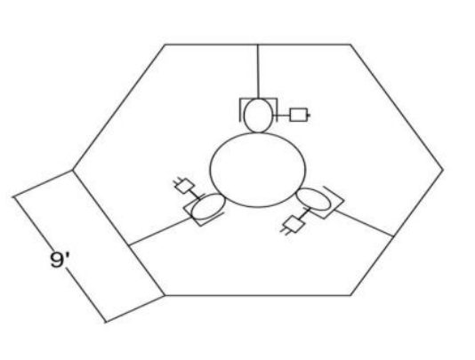
DESIGN AND IMPLEMENTATION
Hexagonal Frame
Aluminium Body
3 + 3 Rubber wheels
Y shaped sprinklers
Battery
Aurdino uno (Bluetooth)
DC Motor - It is rated to operate at 12 V but it can operate at a wide range of voltage of 4 V to 24 V. These motors are available for different speeds and varying torque.
Pesticide Tank carried on Robot.
The entire climbing mechanism and spraying mechanism are controlled by a Android Application.

Slide 32
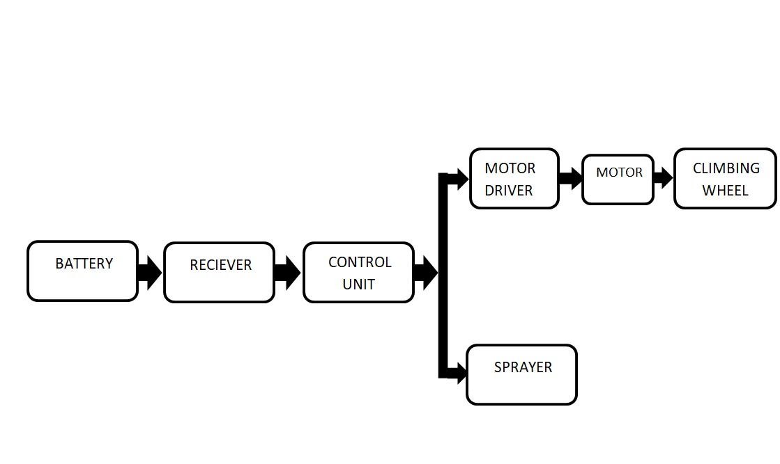
Fig - Block diagram : machine operation control
Reciever is supplied power through the battery.
Through the reciever, control unit gets the instructions.
In control unit we can control the downward and upward movement.
Control unit is connected to
i.Motor driver
ii.Sprayer
Sprayer is used to aim and spray for the arecanut.
Motor driver controls the Climbing wheel movement,stop and start controlling.

Slide 33
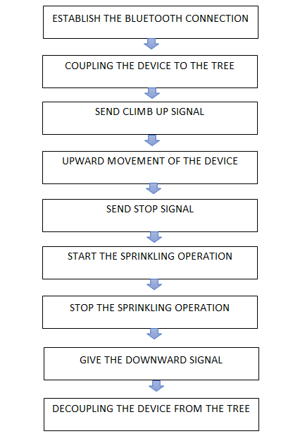

Slide 34
IMPLEMENTATION
The robot will perform the following steps for performing the task:
1) One side of the robotic structure is screwed (coupling and decoupling), it can be opened and fit to any tree. Then the structure is re screwed so that it will fit on to the tree trunk.
2) The robot firstly moves upward through the tree trunk by adjusting its legs according to the dimensions. It is controlled by the operator by giving commands through Android Application.
3) The wheel mechanism is adjusted according to the trunk dimension and to ensure self- Locking ability with the help of compression spring arrangement.
4) The robot then perform the sprinkling work by the help of command provided.
5) Every action of motors are controlled using commands given through android phone, for this purpose a program is developed using visual basic.
6) Wireless communication is done using Xbee RF or Bluetooth module[tentatively].
7)Then after Sprinkling job the Robot moves downwards and the Task gets completed.

Slide 35
SL.NO | YEAR | TITLE | METHODOLOGY
1 | IJICS - Volume 5, Issue 12, December 2018 | Tree Climbing Device | use of X – frame structure and wired connection
2 | IRJET - Apr-2018 | Remote Controlled Arecanut Plucking Machine | Single long frame with spring support, Rope control
3 | JIDPS-Volume-2,Issue-7 (July-2019) | Motorized Arecanut Climber and Pesticide Sprayer | Single beam with two rollers, remote control, wiper sprayers
4 | IJRESM Volume 4, Issue 3, March 2021 | Design and Fabrication of Areca Nut Climber and Harvesting | Use of stick frame and pulley and spring mechanism
5 | IRJGES - Vol. 3, No. 2, June – August 2018 | Autonomous Tree Climber: Robot for Areca Nut Plucking | Triangle and Square frame, Solar panel power supply with dc current, gear motor, remote control
6 | IRJET- 2019 | Design and Fabrication of Arecanut Tree Climbing Machine | Use of triangular frame structure and remote controlled.

Slide 36
7 | IRJET -May 2020 | Design and Demonstration of Solar coco- Areca tree climber and harvester | Triangular frame and use of Solar Charge Controller
8 | IJIRT - June 2020 | Arecanut Tree Climber and Pesticide Sprayer | Use of ‘Y’ – frame , automatically controlled by RF transceiver but use of battery.
9 | IJLERA-Volume–05, Issue–08,Aug 2020, PP – 37-40 | Removing the Bunch of Areca Nut from the Plant and Spraying of Pesticide by using Remote Operated Device | Use of ‘Y’ – frame , automatically controlled by RF transceiver but Use of petrol Engine.
10 | IJERT- 2019 | Smart Arecanut Plucking Robot | Use of square frame structure , use of engines and wired connection
11 | IRJET- Apr 2021 | Automated Pesticide Sprayer for Arecanut | Use of Square frame structure, use of DC motors and wired connection
12 | Research Gate - April 2021 | Design and Implementation of Agricultural Drone for Areca Nut Farms | Use of drone , in-built tank for spraying pesticide and controlled over Remote

Slide 37
THANK YOU

